Slide 1
CSI ZG515/ SS ZG515 Data Warehousing
Swarna Chaudhary
Assistant Prof.

Slide 2
OLAP & Multidimensional Databases (MDDB)

Slide 3
Lecture Objectives
Explain concepts of OLAP
Various OLAP operations with examples
Relative strengths of MOLAP, ROLAP, and HOLAP

Slide 4
Two Broad Types of database activity
OLTP – Online Transaction Processing
Short transactions
Simple queries
Touch small portions of data
Frequent updates
OLAP – Online Analytical Processing
Long transactions
Complex queries
Touch large portions of the data
Infrequent updates
Discover patterns and trends
Also called decision support queries

Slide 5
From Tables and Spreadsheets to Data Cubes
A data warehouse is based on a multidimensional data model which views data in the form of a data cube.
Although we usually think of cubes as 3-D geometric structures, in data warehousing the data cube is n-dimensional.

Slide 6
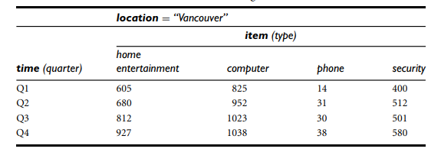
Data Cube : 2-D Table View
A 2-D view of sales data for AllElectronics according to the dimensions time and item, where the sales are from branches located in the city of Vancouver. The measure displayed is dollars sold.

Slide 7
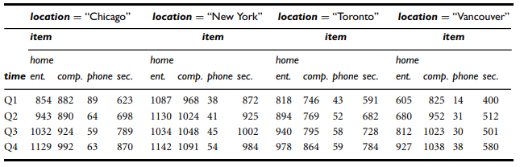
Data Cube : 3-D Table View
A 3-D view of sales data for AllElectronics, according to the dimensions time, item, and location. The measure displayed is dollars sold.
The 3-D data is represented as a series of 2-D tables.

Slide 8
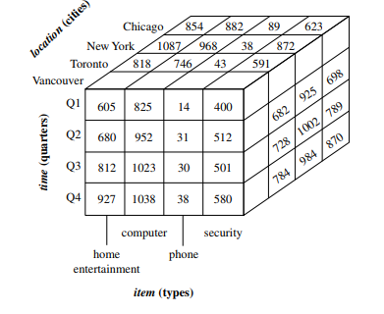
Data Cube : 3-D Cube Representation
A 3-D data cube representation of the data, according to the dimensions time, item, and location. The measure displayed is dollars sold.

Slide 9
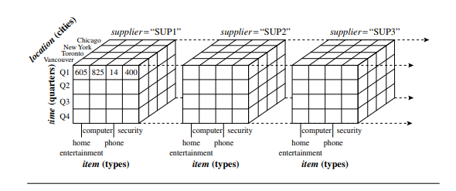
Data Cube : 4-D Cube Representation
Suppose that we would now like to view our sales data with an additional fourth dimension, such as supplier.
Viewing things in 4-D becomes tricky. However, we can think of a 4-D cube as being a series of 3-D cubes.
A 4-D data cube representation of sales data, according to the dimensions time, item, location, and supplier. The measure displayed is dollars sold.

Slide 10
Data Cube : n-D
We can think of a 4-D cube as being a series of 3-D cubes, as shown previously.
If we continue in this way, we may display any n-D data as a series of (n-1) – D cubes.
The data cube is a metaphor for multidimensional data storage.
The actual physical storage of such data may differ from its logical representation.
The important thing to remember is that data cubes are n-dimensional, and do not confine data to 3-D.

Slide 11
Cuboids
The tables shown in previous example show the data at different degrees of summarization.
In the data warehousing research literature, a data cube such as each of the examples is referred to as a cuboid.
Given a set of dimensions, we can construct a lattice of cuboids, each showing the data at a different level of summarization, or group by (i.e., summarized by a different subset of the dimensions). The lattice of cuboids is then referred to as a data cube.
The cuboid which holds the lowest level of summarization is called the (n-D) base cuboid.
The top most 0-D cuboid, which holds the highest-level of summarization, is called the apex cuboid. E.g. Total sales summarized for all dimensions.
For example, 3-D cuboid for time, item, and location, summarized for all suppliers.
The lattice of cuboids forms a data cube.

Slide 12
Cube: A Lattice of Cuboids
all
0-D (apex) cuboid
time
item
location
supplier
1-D cuboids
time,location
item,location
location,supplier
time,item
2-D cuboids
time,supplier
item,supplier
time,location,supplier
3-D cuboids
time,item,location
time,item,supplier
item,location,supplier
4-D (base) cuboid
time, item, location, supplier

Slide 13
What is OLAP?
OLAP is a category of software technology that enables analysts, managers, and executives to gain insight into data through fast, consistent, interactive access to a wide variety of possible views of information that has been transformed from raw data to reflect the real dimensionality of the enterprise as understood by the user.

Slide 14
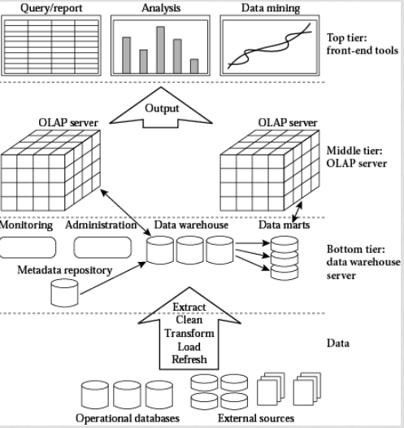
OLAP and Data Warehouse

Slide 15
OLAP and Data Warehouse
Typically, OLAP queries are executed over a separate copy of the working data
Over data warehouse
Data warehouse is periodically updated,
Why run OLAP queries over data warehouse??
Warehouse collects and combines data from multiple sources
Warehouse may organize the data in certain formats to support OLAP queries
OLAP queries are complex and touch large amounts of data
They may lock the database for long periods of time •
Negatively affects all other OLTP transactions

Slide 16
OLAP vs Data Mining
OLAP and data mining are used to solve different kinds of analytic problems:
OLAP summarizes data and makes forecasts. For example, OLAP answers questions like "What are the average sales of cars, by region and by year?"
Data mining discovers hidden patterns in data. Data mining operates at a detail level instead of a summary level. Data mining answers questions like "Who is likely to buy luxury cars, and what are the characteristics of these likely buyers?"
OLAP and data mining can complement each other. For example, OLAP might pinpoint problems with sales of cars in a certain region. Data mining could then be used to gain insight about the behavior of individual customers in the region. Finally, after data mining predicts something like a 5% increase in sales, OLAP can be used to track the net income.
Source: https://docs.oracle.com/cd/B19306_01/server.102/b14223/bi.htm

Slide 17
Possible OLAP Queries
1. How did hp laptop sell in the last month, and how does this figure compare with sales over the last five years? How about by branch, region and territory?
2. Did this product sell better in different regions, and are there any regional trends?
3. Were there more returns of laptops over the last year? Were these returns caused by defects?

Slide 18
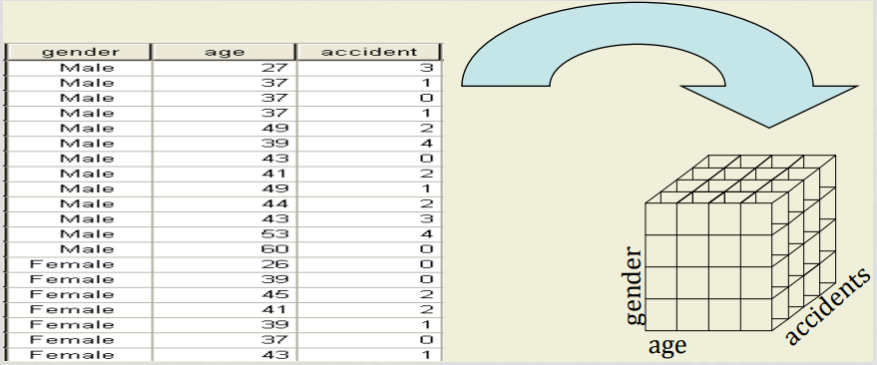
Multi-Dimensional View

Slide 19
Hypercube
Hypercube is a representation that accommodates more than three dimensions.
A hypercube is a general metaphor for representing multidimensional data.

Slide 20
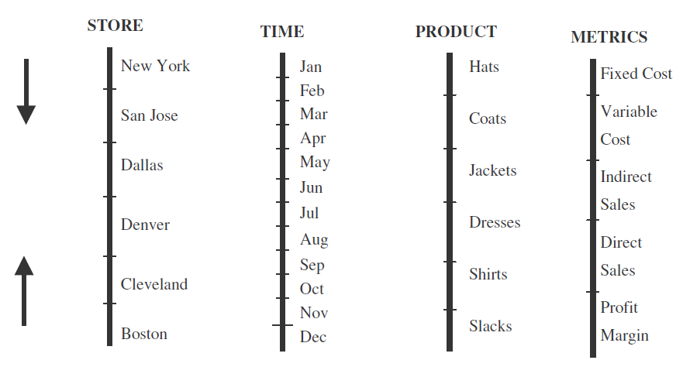
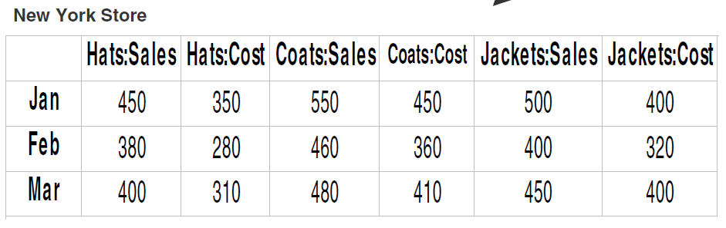
Hypercube
Multidimensional Domain Structure with 4-D
Display for 4-D data

Slide 21
Codd’s Rules for OLAP
Multidimensional Conceptual View. Provide a multidimensional data model that is intuitively analytical and easy to use. Business users' view of an enterprise is multidimensional in nature. Therefore, a multidimensional data model conforms to how the users perceive business problems.
Transparency Make the technology, underlying data repository, computing architecture, and the diverse nature of source data totally transparent to users. Such transparency, supporting a true open system approach, helps to enhance the efficiency and productivity of the users through front-end tools that are familiar to them.
Accessibility Provide access only to the data that is actually needed to perform the specific analysis, presenting a single, coherent, and consistent view to the users. The OLAP system must map its own logical schema to the heterogeneous physical data stores and perform any necessary transformations.
Consistent Reporting Performance Ensure that the users do not experience any significant degradation in reporting performance as the number of dimensions or the size of the database increases. Users must perceive consistent run time, response time, or machine utilization every time a given query is run.
Client/Server Architecture Conform the system to the principles of client/server architecture for optimum performance, flexibility, adaptability, and interoperability. Make the server component sufficiently intelligent to enable various clients to be attached with a minimum of effort and integration programming.
Generic Dimensionality Ensure that every data dimension is equivalent in both structure and operational capabilities. Have one logical structure for all dimensions. The basic data structure or the access techniques must not be biased toward any single data dimension.

Slide 22
Codd’s Rules for OLAP
Dynamic Sparse Matrix Handling Adapt the physical schema to the specific analytical model being created and loaded that optimizes sparse matrix handling. When encountering a sparse matrix, the system must be able to dynamically deduce the distribution of the data and adjust the storage and access to achieve and maintain consistent level of performance.
Multiuser Support Provide support for end users to work concurrently with either the same analytical model or to create different models from the same data. In short, provide concurrent data access, data integrity, and access security.
Unrestricted Cross-dimensional Operations Provide ability for the system to recognize dimensional hierarchies and automatically perform roll-up and drill-down operations within a dimension or across dimensions. Have the interface language allow calculations and data manipulations across any number of data dimensions, without restricting any relations between data cells, regardless of the number of common data attributes each cell contains.
Intuitive Data Manipulation Enable consolidation path reorientation (pivoting), drill-down and roll-up, and other manipulations to be accomplished intuitively and directly via point-and-click and drag-and-drop actions on the cells of the analytical model. Avoid the use of a menu or multiple trips to a user interface.
Flexible Reporting Provide capabilities to the business user to arrange columns, rows, and cells in a manner that facilitates easy manipulation, analysis, and synthesis of information. Every dimension, including any subsets, must be able to be displayed with equal ease.
Unlimited Dimensions and Aggregation Levels Accommodate at least fifteen, preferably twenty, data dimensions within a common analytical model. Each of these generic dimensions must allow a practically unlimited number of user-defined aggregation levels within any given consolidation path.

Slide 23

An Analysis Session
Sharp enterprise-wide profitability dip
Countrywide monthly sales for last 3 months?
Sales OK, profitability down last 3 months
Monthly sales by worldwide regions?
Sharp reduction in European region
European sales by countries ?
Increase in a few countries, flat in others, sharp decline in some
European sales by countries, products?
Additional tax on some products in EU
Direct and indirect costs for EU countries?
Sharp decline in EU countries, last 2 months
Direct costs OK, indirect costs up

Slide 24
Features of OLAP
Multidimensional analysis | Consistent performance | Fast response times for interactive queries
Drill-down and roll-up | Navigation in and out of details | Slice-and-dice or rotation
Multiple view modes | Easy scalability | Time intelligence (year to-date, fiscal period)
Basic Features
Advanced Features
Powerful calculations | Cross-dimensional calculations | Pre-calculation or pre-consolidation
Drill-through across dimensions or details | Sophisticated presentation & displays | Collaborative decision making
Derived data values through formulas | Application of alert technology | Report generation with agent technology

Slide 25

How OLAP Systems Work?
Data stored in a Data warehouse is organized into data cubes.
Each OLAP cube contains data categorized by different dimensions (such as customers, geographic sales region and time period) derived by dimensional tables in the data warehouses.
Dimensions are then populated by members (such as customer names, countries and months) that are organized hierarchically.
OLAP cubes are often pre-summarized across dimensions to drastically improve query time over relational databases.

Slide 26
OLAP Operations

Slide 27
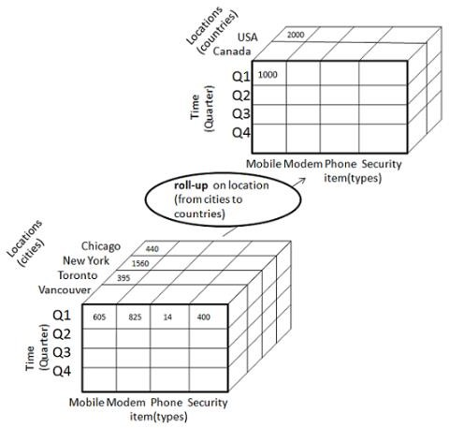
OLAP – Roll up
The following diagram illustrates how roll-up works
Roll-up is performed by climbing up a concept hierarchy for the dimension location.
Initially the concept hierarchy was "street < city < province < country".
On rolling up, the data is aggregated by ascending the location hierarchy from the level of city to the level of country.

Slide 28
OLAP – Roll up
ROLLUP is used in tasks involving subtotals. It creates subtotals at any level of aggregation needed, from the most detailed up to a grand total i.e. climbing up a concept hierarchy for the dimension such as time or geography. Example : A Query could involve a ROLLUP of year>month>day or country>state>city.
QUERY SYNTAX:
SELECT …GROUP BY ROLLUP ( GROUPING_COLUMN_REFERENCE_LIST);
EXAMPLE:
SELECT year, brand, SUM(quantity) FROM SALES GROUP BY ROLLUP(year, brand);
ROLL UP operation example would return the total quantity sold across all brands
The Query calculates the standard aggregate values specified in the GROUP BY clause. Then, it creates progressively higher-level subtotals, moving from right to left through the list of grouping columns. Finally, it creates a grand total.
**OLAP such as CUBE, ROLLUP added to SQL 99 are more convenient
CUBE Operator aggregates the facts in each level of each dimension in a given OLAP schema

Slide 29
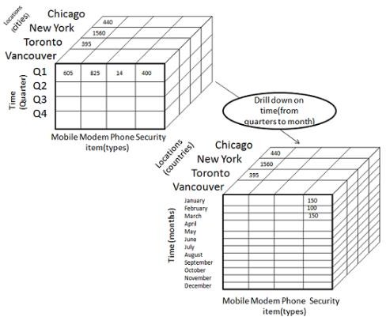
OLAP – Drill Down
Drill-down is the reverse operation of roll-up.
The following diagram illustrates how drill-down works:
Drill-down is performed by stepping down a concept hierarchy for the dimension time.
Initially the concept hierarchy was "day < month < quarter < year."

Slide 30
OLAP – Drill Down
This is a reverse of the ROLL UP operation discussed above. The data is aggregated from a higher level summary to a lower level summary/detailed data.
QUERY SYNTAX:
SELECT … GROUP BY (COLUMNS);
EXAMPLE:
SELECT year, brand, SUM(quantity) FROM SALES GROUP BY (year, brand);

Slide 31
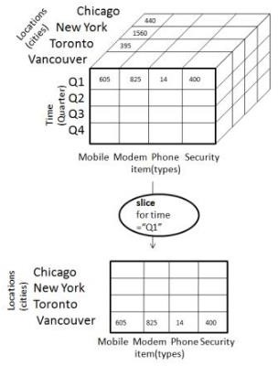
OLAP – Slice
The slice operation selects one particular dimension
from a given cube and provides a new
sub-cube.

Slide 32
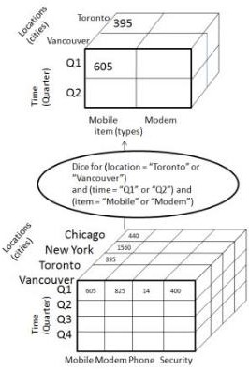
OLAP – Dice
Dice selects two or more dimensions from a given cube and provides a new sub-cube.
Consider the following diagram that shows the dice operation.
The dice operation on the cube based on the
following selection criteria involves three
dimensions.
(location = "Toronto" or "Vancouver")
– (time = "Q1" or "Q2")
(item =" Mobile" or "Modem")

Slide 33
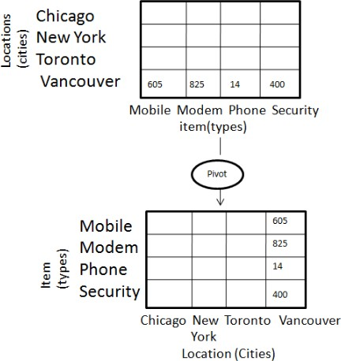
OLAP – Pivot
The pivot operation is also known as rotation.
It rotates the data axes in view in order to
provide an alternative presentation of
data.

Slide 34
OLAP operations
LINE | 1998 | 1999 | 2000 | TOTAL
Clothing | $3,457,000 | $3,590,050 | $5,789,400 | $12,836,450
Electronics | $5,894,800 | $4,078,900 | $6,094,600 | $16,068,300
Video | $7,198,700 | $6,057,890 | $8,005,600 | $21,262,190
Kitchen | $4,875,400 | $5,894,500 | $6,934,500 | $17,704,400
Appliances | $5,947,300 | $6,104,500 | $7,549,000 | $19,600,800
Total | $27,373,200 | $25,725,840 | $34,373,100 | $87,472,140
Drill down
LINE | TOTAL SALES
Clothing | $12,836,450
Electronics | $16,068,300
Video | $21,262,190
Kitchen | $17,704,400
Appliances | $19,600,800
Total | $87,472,140
Rotate / Pivot
YEAR | Clothing | Electronics | Video | Kitchen | Appliances | TOTAL
1998 | $3,457,000 | $5,894,800 | $7,198,700 | $4,875,400 | $5,947,300 | $27,373,200
1999 | $3,590,050 | $4,078,900 | $6,057,890 | $5,894,500 | $6,104,500 | $25,725,840
2000 | $5,789,400 | $6,094,600 | $8,005,600 | $6,934,500 | $7,549,000 | $34,373,100
Total | $12,836,450 | $16,068,300 | $21,262,190 | $17,704,400 | $19,600,800 | $87,472,140

Slide 35
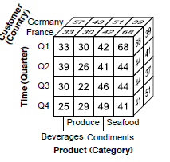
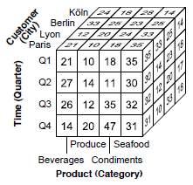
Examples
Compare the sales quantity by country
Roll-up to country level

Slide 36
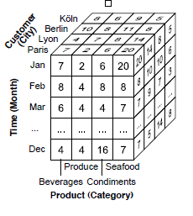
Examples
To understand the sales of “seafood” in January
Drill-down to month level

Slide 37
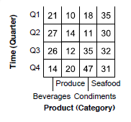
Examples
Visualize data only for “Paris”
Slice on city = “Paris”

Slide 38
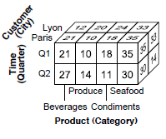
Examples
Visualize data only for “Paris” and “Lyon” for quarter Q1 and Q2
dice on city and quarter

Slide 39
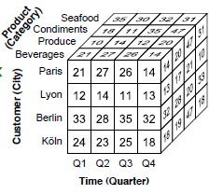
Examples
Visualize the cube with time dimension on x-axis
pivot

Slide 40
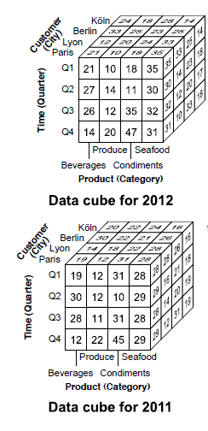
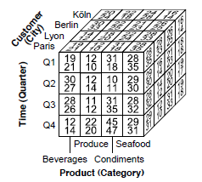
Examples
Compare the sales of 2011 with 2012
drill-across
Drill-Across executes query involving more than one fact table

Slide 41
OLAP Models

Slide 42
ROLAP VS MOLAP
ROLAP is an extended RDBMS along with multidimensional data mapping to perform the standard relational operation.
It is built on top of relational database
ROLAP engine resides on desktop
MOLAP, is implemented by storing the data multidimensionally, MDD are vendors’ proprietary system
It is implemented through a specialised multidimensional database.
Proprietary MDDs are required

Slide 43
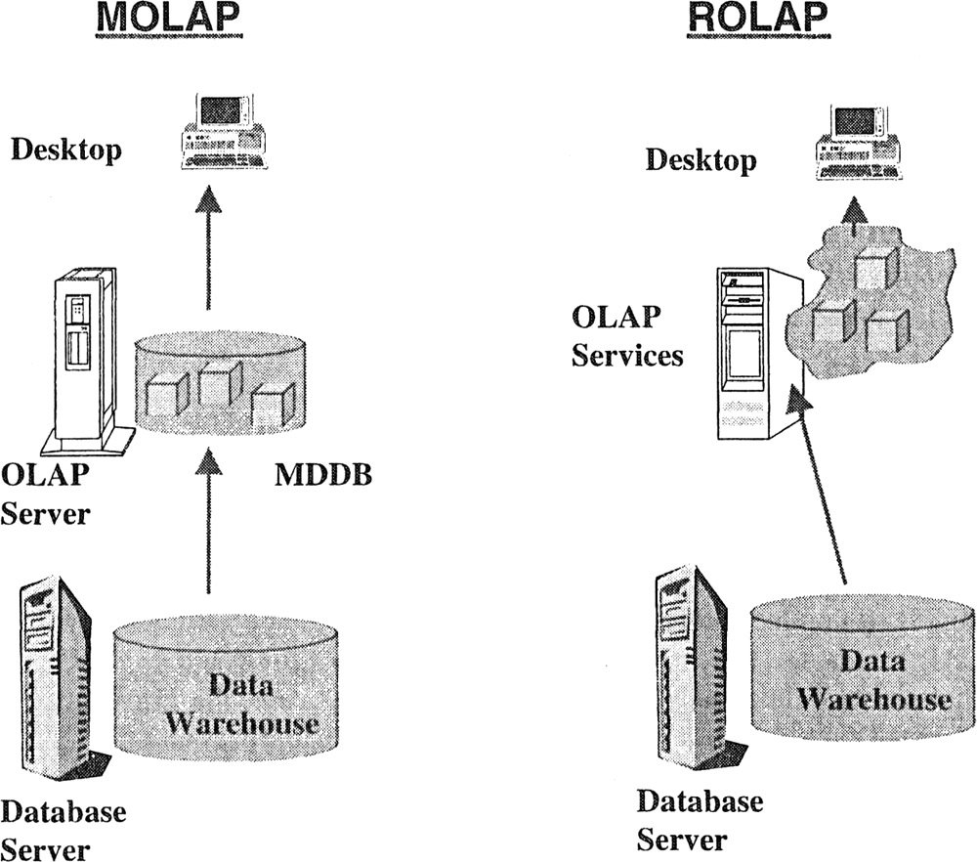
Distinct OLAP models

Slide 44
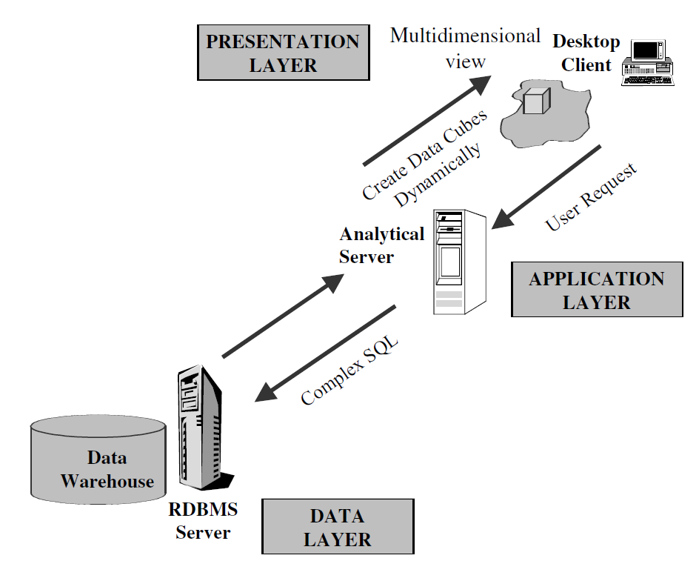
ROLAP Models
The data is stored as in relational database i.e. rows and columns in the data warehouse.
In this model data is presented to the user in the multidimensional form.
To display the data, in a multidimensional view, a semantic layer of metadata is created that maps dimension to the relational tables.
Metadata also supports aggregation of the data.
Whenever the ROLAP engine in analytical server issues a complex query, it fetches data from the main warehouse and dynamically creates a multidimensional view of data for the user.

Slide 45
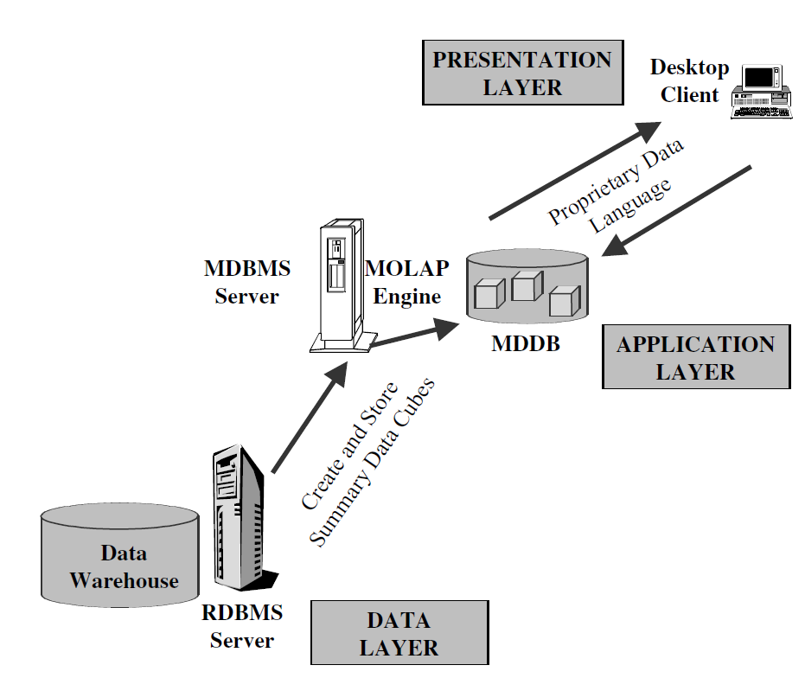
MOLAP Models
Precalculated and prefabricated multidimensional data cubes are stored in multidimensional databases.
The MOLAP engine in the application layer pushes a multidimensional view of the data
from the MDDBs to the users.

Slide 46
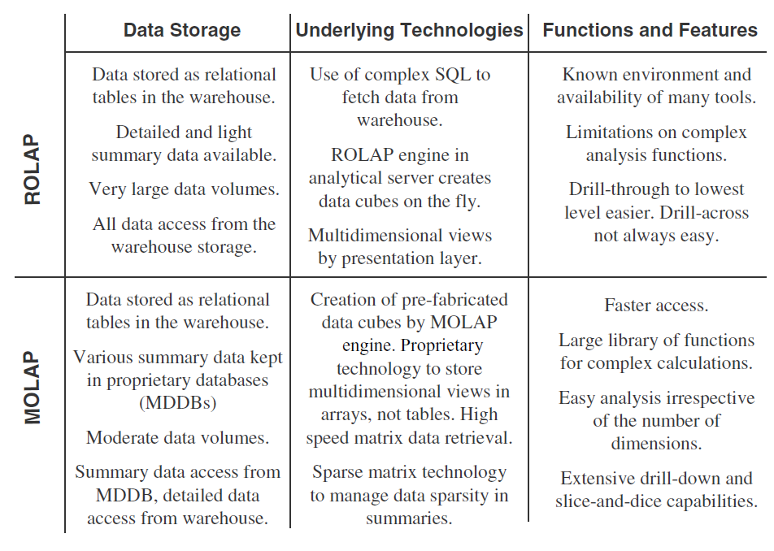
ROLAP vs MOLAP

Slide 47
HOLAP (Hybrid OLAP)
Hybrid OLAP is a combination of both ROLAP and MOLAP. It offers higher scalability of ROLAP and faster computation of MOLAP. HOLAP servers allows to store the large data volumes of detailed information. The aggregations are stored separately in MOLAP store..

Slide 48
Q & A

Slide 49
Thank You

